Slide 1
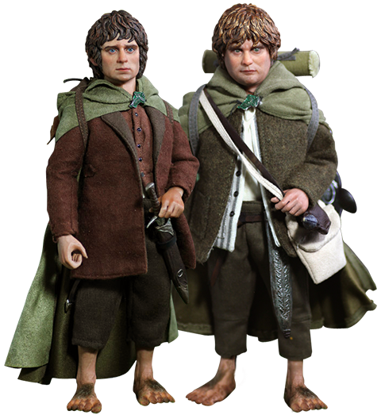
Helping the Hurting
How do we walk alongside others in their battle with emotional illness?
New Covenant Mennonite Fellowship
Ladies’ Conference
January 18, 2024
LuAnne D. Yeager, MD
Notes:
Bambi asked if I could come and share on how to walk alongside others in their battles with depression and anxiety
Haven’t we all been there—wanting to help someone in the worst way, but feeling so ill-prepared?!! (I don’t know what to say!)
My goal in speaking with you tonight is to impress on your hearts the fact that what we have to offer each other AS CHILDREN OF GOD far surpasses what the medical field has to offer
I’m hoping that you leave here believing that the best preparation for helping others is the simple belief in the Good News of the Gospel of Jesus Christ.
I’m wanting to stir up our hearts to set our cell phones aside and go back to the good old-fashioned concept of cultivating relationships, where we share the ups and downs of life together—like Frodo and Samwise Gamgee did in the story of the LOTR.
Rebecca St. James sang a song many years ago now called “I’llCarry You.”
She wrote it after having witnessed a race in which one of the runners collapsed close to the end of the race. Two of her friends saw that she wasn’t going to reach the finish line at all, and knowing how much work she put into preparation for the race, they ran down onto the road, picked her up, and carried her across the finish line.
I know that look in your eyes—I see the pain behind your smile; Please don’t hold it all inside.
Together we can run to the finish line, and when you are tired, I’ll Carry You!
I can’t walk this road without you, You cannot go it alone
We were never meant to make it on our own
When the load becomes too heavy, And your feet too tired to walk
I will carry you, and we’ll be carried on
This is the direction we are going in our talk tonight.

Slide 2
Who I am:
Notes:
Keep this short and sweet, b/c this talk is not about me. However, we don’t know each other…
I’m married to Joel.
We just had our 31th anniversary.
One of the Unforeseen Details of our life together is that we don’t have children / We’ve accepted this as “Divine Design”

Slide 3
Where We Live:
Notes:
We live in Schaefferstown, which is in Lebanon County.
If you’re familiar with Schaefferstown, you might know where Keller Bro. Ford is...
My parents live in the red section of the house; the barn on the left is our office

Slide 4
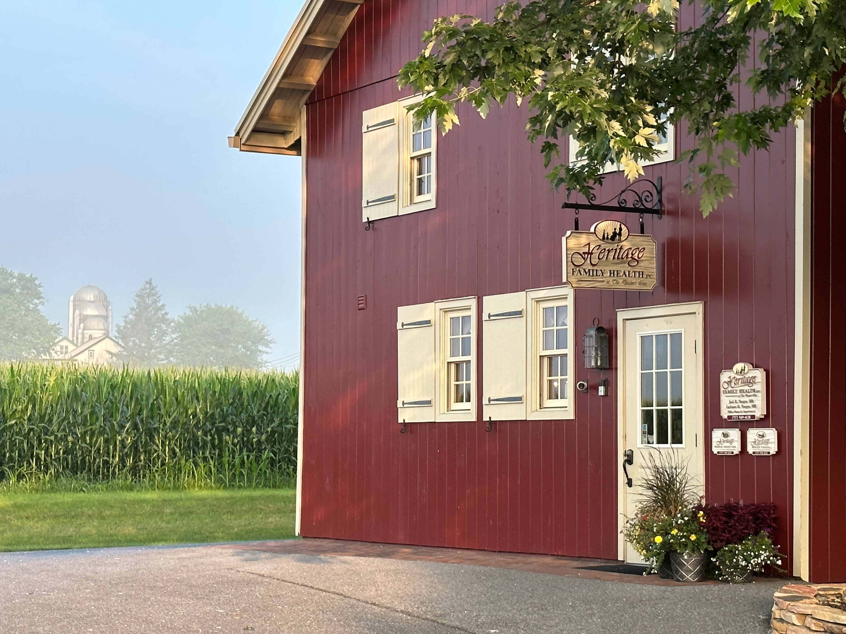
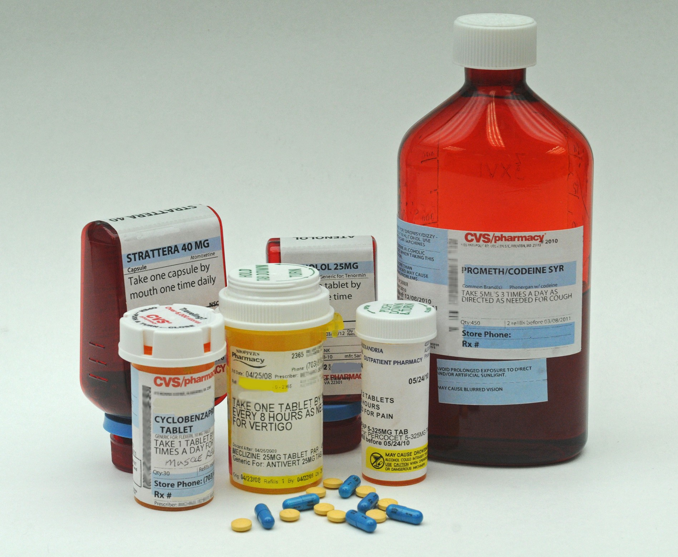
What We Do:
Notes:
Both Joel and I are family doctors, so we see everything from the beginning of life to the end of life.
One of the more recent additions to our practice is that we got certified in herbal medicine.

Slide 5
Our Furry Friends:
Bella
Mollie
Tucker

Slide 6
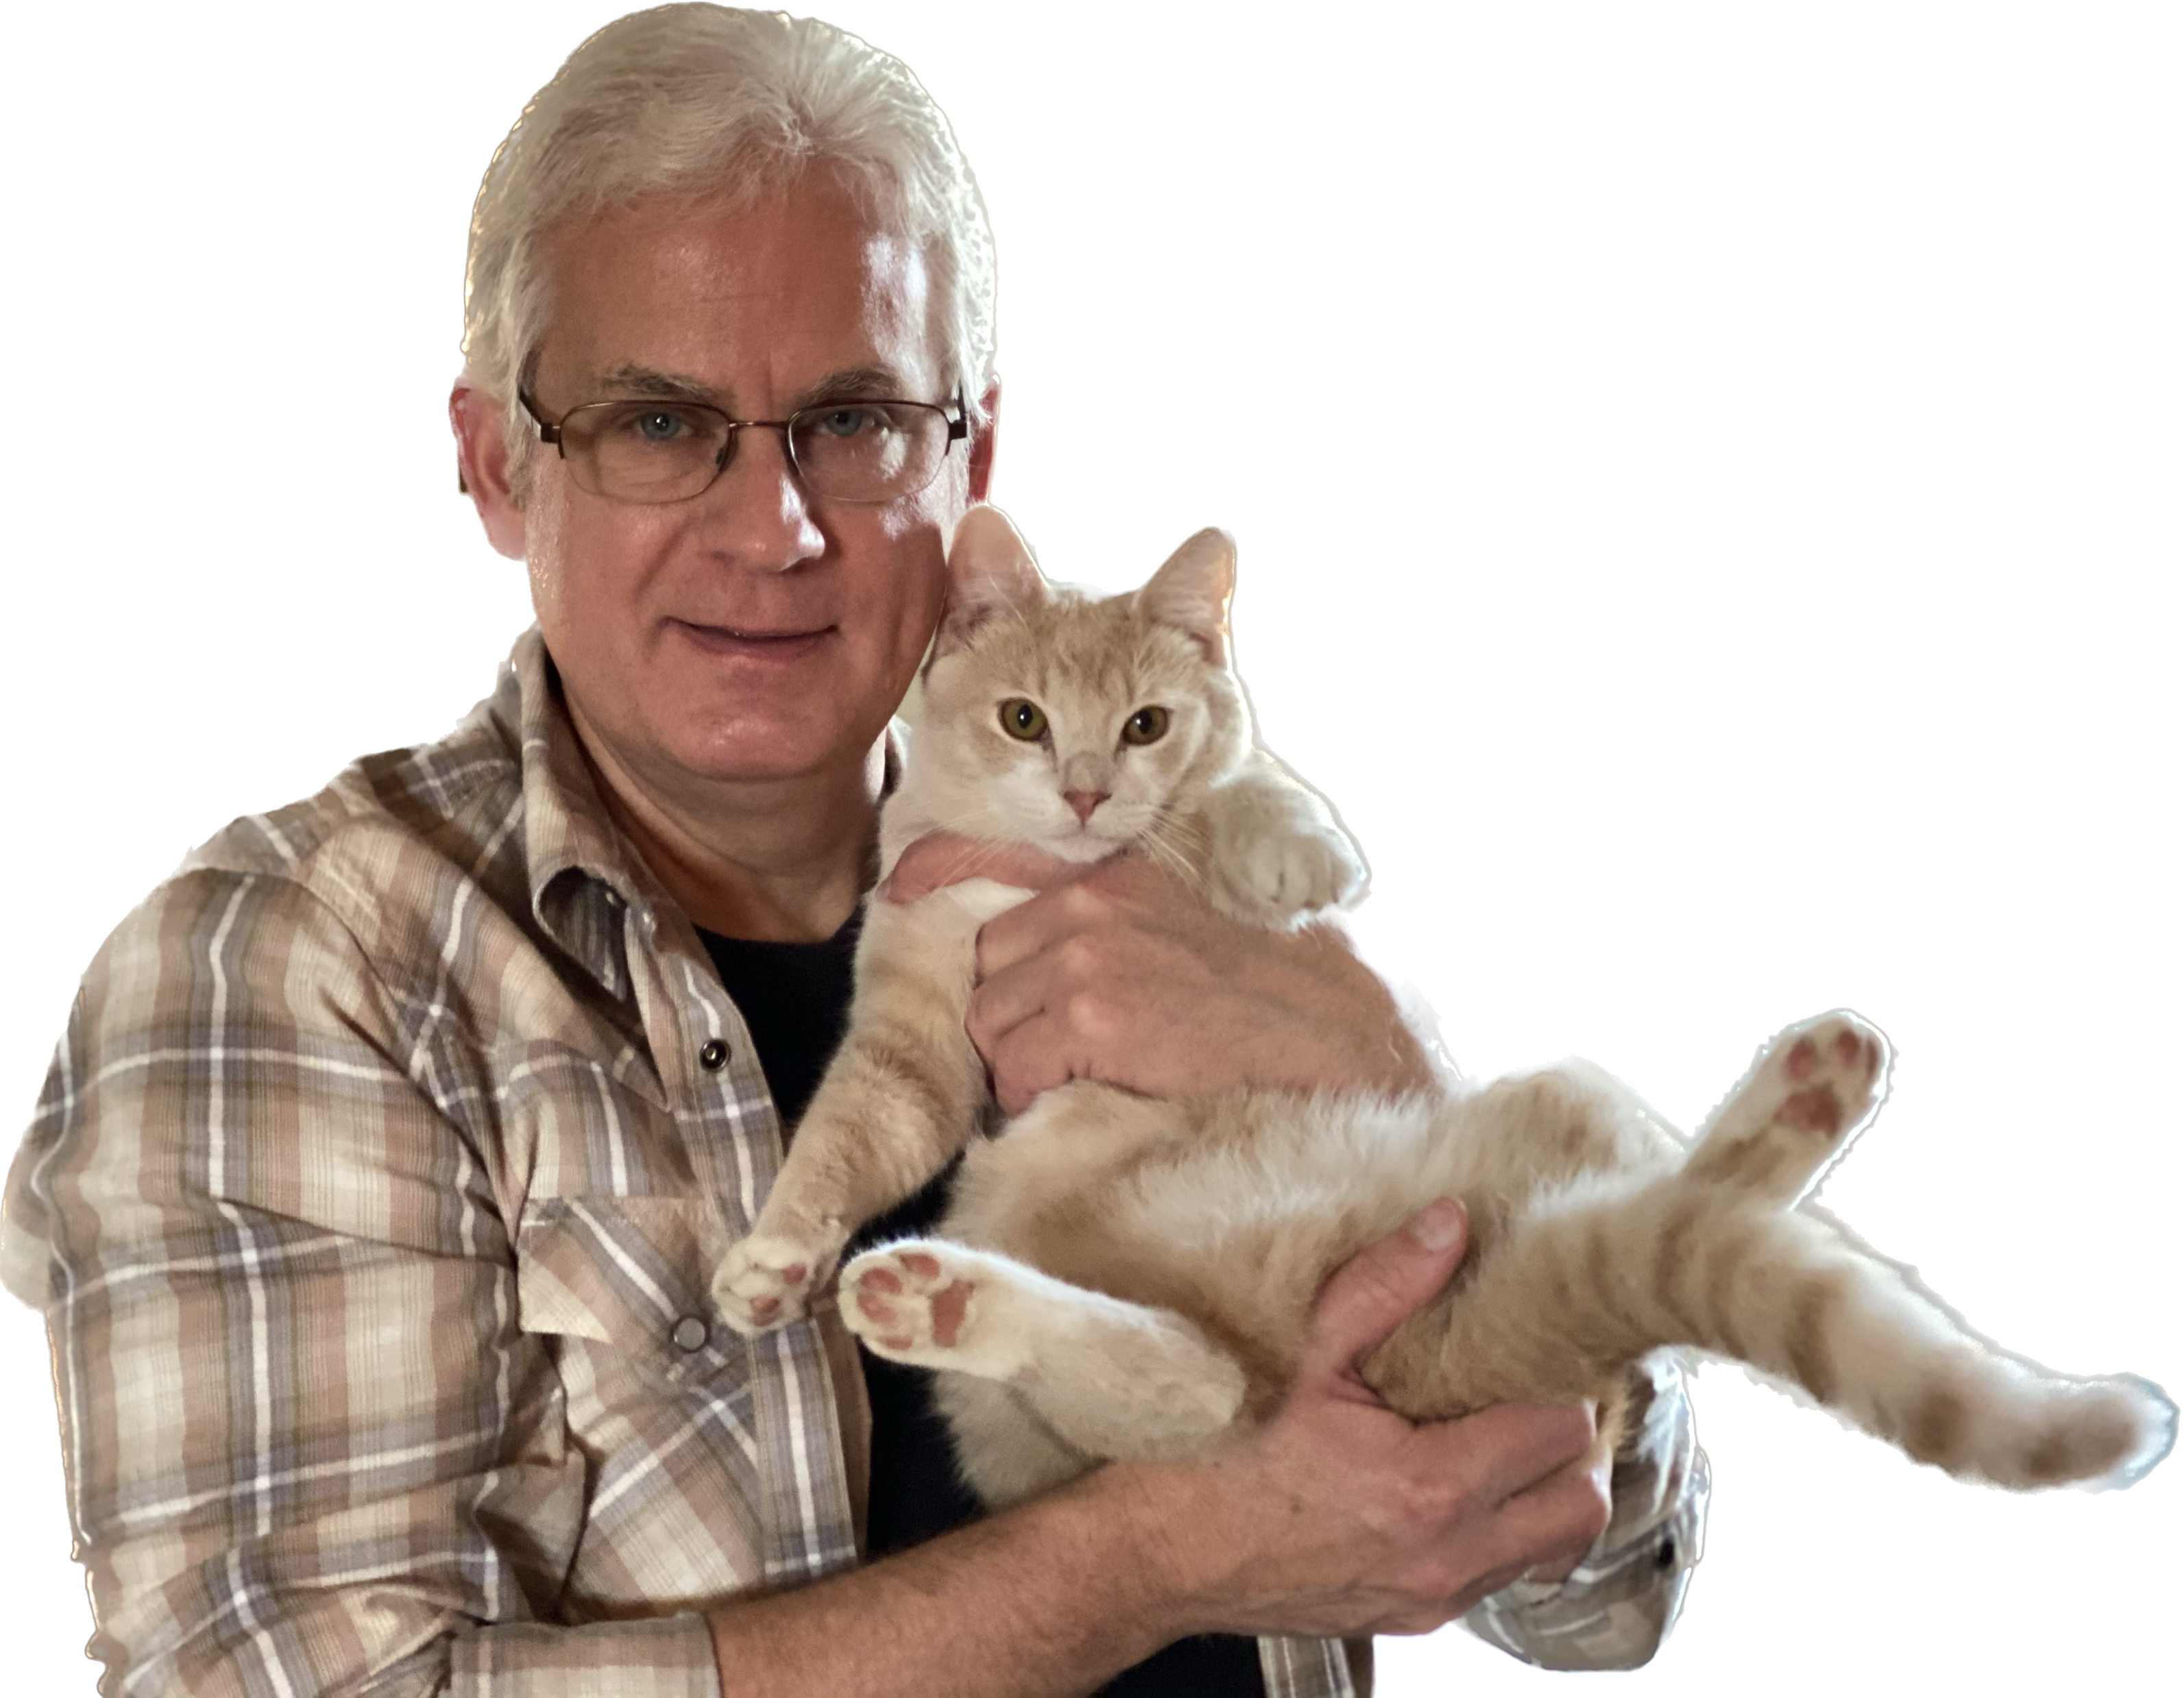
Gilbert

Slide 7
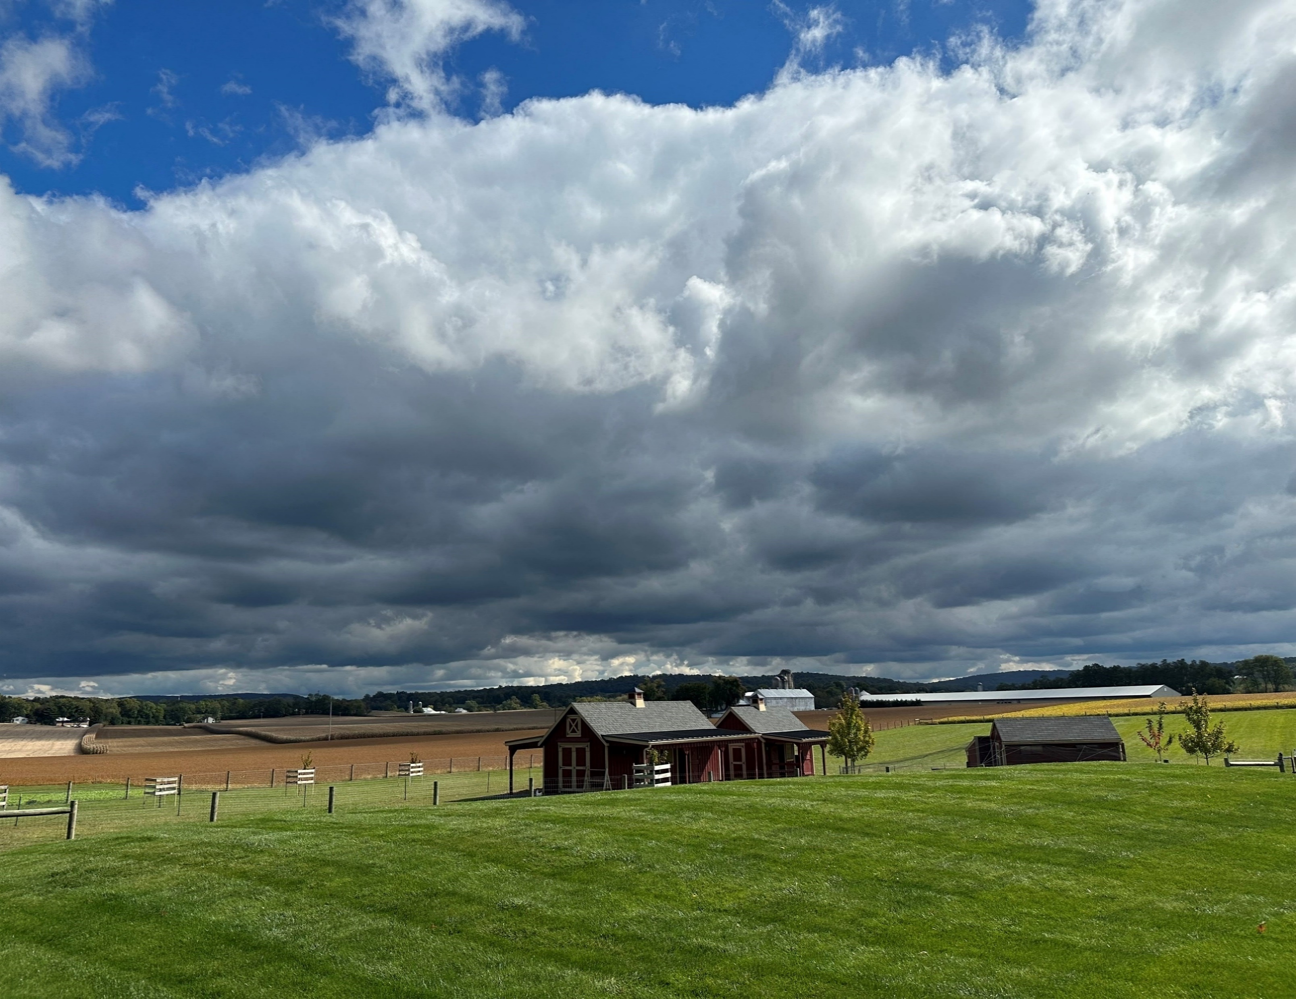
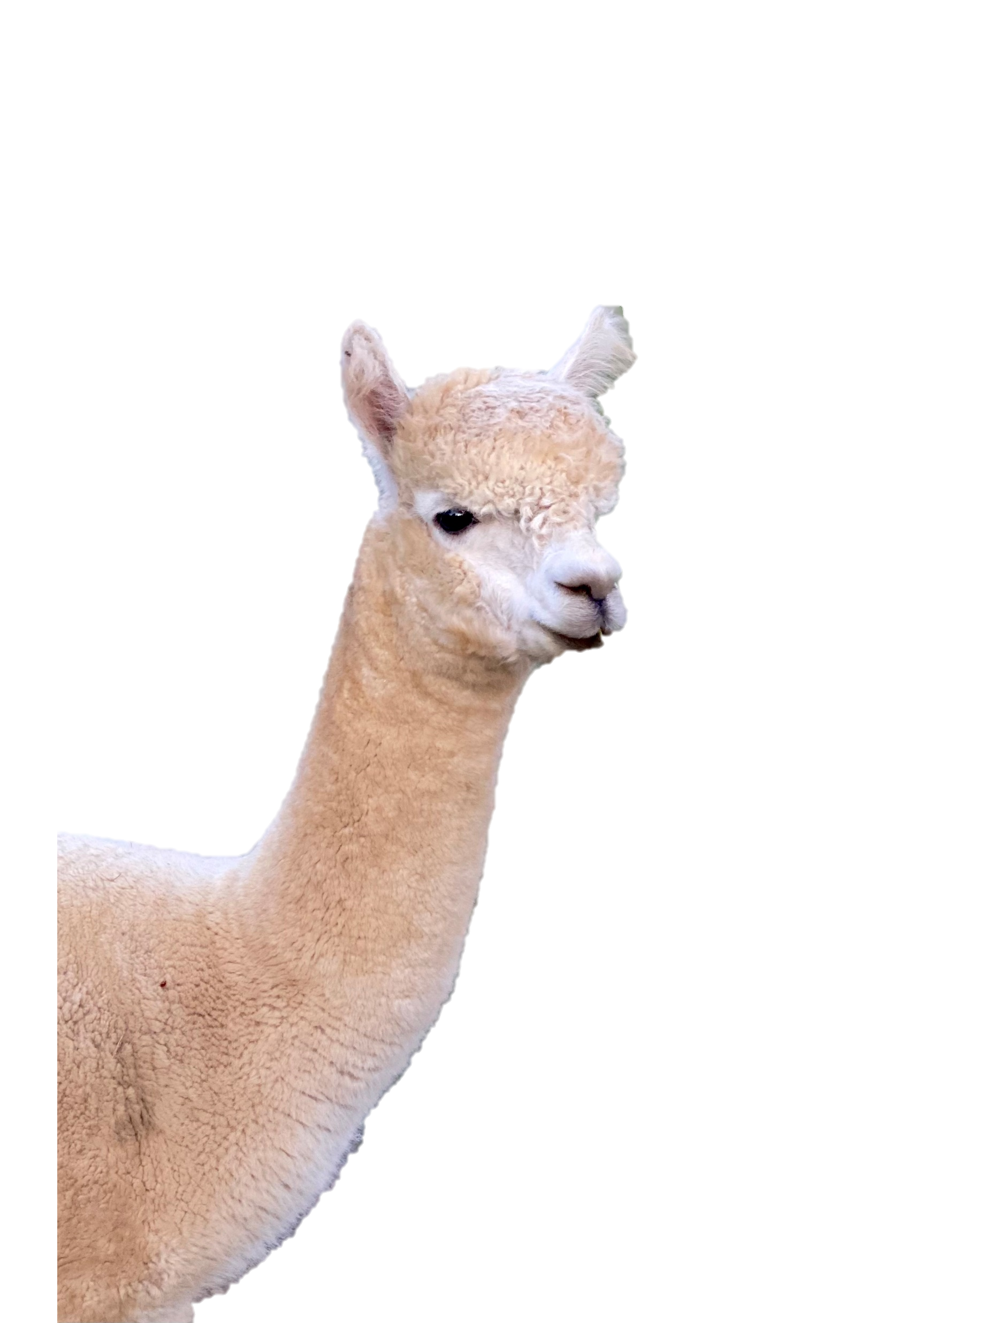
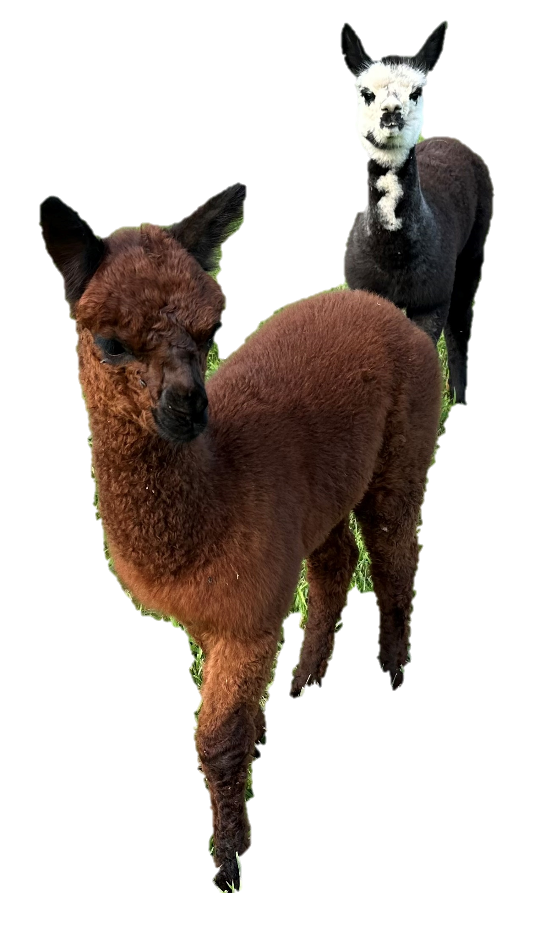
Notes:
And since we have a small meadow in the back of our property, we started raising alpacas.
BUT…although these are details about my life,
my chief identity is that I am a child of God.
Each new day is another day of grace,
and for me to live is Christ.

Slide 8
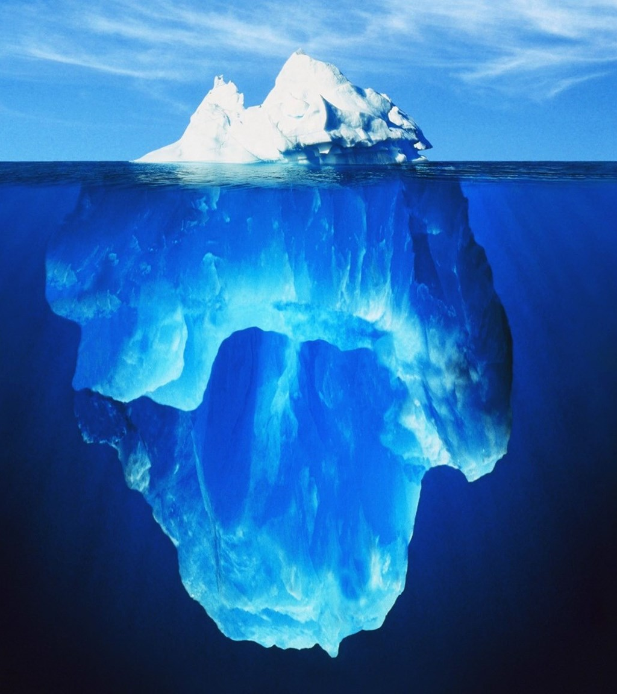
Objectives:
The Journey of Life
Radical change after being born again!
“Bedrock” – foundations for journeying well
“Upper & Lower Rooms”
Very brief look at a few specific emotional struggles
Notes:
Start with a caveat of what this talk is NOT about: I appreciate the fact that we are all at different places in our journeys and we all have unique quests and callings:
Hence, I’m not going to try to convince you one way or the other that medication is a good idea or a bad one
I have no idea if there are any counselors or psychologists in this crowd. I’m not interested in suggesting that one approach to counseling is better than the next.
And I also want to acknowledge that there are likely many of you who are currently in the midst of an emotional struggle. In presenting a talk like this, it is not particularly helpful to speak vaguely. So please hear me say that my intention is not judgmental if you hear me say something that feels like criticism of your current experience.
So what we WILL do is look at some foundational concepts in what drives our behavior and our struggles. You’ve certainly heard the illustration of how counseling looks deeper than the tip of an iceberg. When we connect a few dots of some of those underlying issues, it helps make sense of the more visible problems that we see in our lives.
Objectives:
Look at life in a metaphorical way—as a journey, with a radical shift in the direction of life at conversion
Look at the question of how to journey well; I chose to name these points as “bedrock,” given the fact that they are foundational
I then want to consider briefly a helpful concept that Larry Crabb proposed as a tool for counseling in one of his books; he called it the “upper and lower room” analogy
The last part is looking at specific emotional illnesses
Prayer
We thank you, Heavenly Father, for this time together this evening.
Thank you for the bond of love that is present in Christ.
We ask for your presence with us and that Your Spirit will minister each person here according to their unique need,
And I pray that we would be able to leave this place tonight with a renewed sense of the beauty of the Gospel of Christ, which is the power of God for the radical changing of lives.
This we ask in Jesus’ name. Amen.

Slide 9
Life is a Journey
Metaphorical
Life is bigger than this moment
Helpful to have a “visual” of the bigger picture
Notes:
My husband spent a year studying Biblical Counseling at Larry Crabb’s program in CO back in 1996.
Instead of walking into a classroom and learning a bunch of techniques for counseling, they spent the bulk of the year BEING counseled.
The reason for this is that we can’t lead others in directions that we ourselves have not walked.
hence I want to spend the first part of our talk looking at our own lives.
those who never look deeply into the struggles of their own hearts will not offer helpful guidance to others in their struggles!
If the blind lead the blind…!
When sitting with patients, it is not unusual for me to grab a tablet and draw a squiggly line…[point #2 and #3 above]

Slide 10
How Do We Journey Well?
Break down our personal journeys into “Before Conversion” and “After Conversion”
How possible is it to journey well BEFORE we are saved?
Tools that benefit everybody:
Disciplined living (i.e. going to bed, getting up, making your bed, limiting screen time)
Hard work ethic
Learn responsibility / dependability
Notes:
Read entire slide
Mothers in the audience tonight, these good old values are just as necessary today as they were 100 years ago.
I feel we have so many distractions today / so busy / waste too much time on our phones
Make child training your PRIORITY! These tools of hard work/responsibility will benefit your children their entire lifetime
I have often made the comment that I successfully made it through medical school b/c I first learned how to successfully complete picking 15 rows of beans!
3. ALL OUR STORIES GOT MESSED UP. We have a common theme in this way.
No matter how good or not-so-good our parents were, in one way or another, our journeys got messed up early on, right?!
I see too many people believing that their lives would be so much better today IF ONLY this bad thing wouldn’t have happened…
my guess is that there are chapters in ALL our stories that we wish we could delete or do over
I’m wanting us to connect the dots that ALL of our lives have started in a Broken Down World, and we all have a common start:

Slide 11
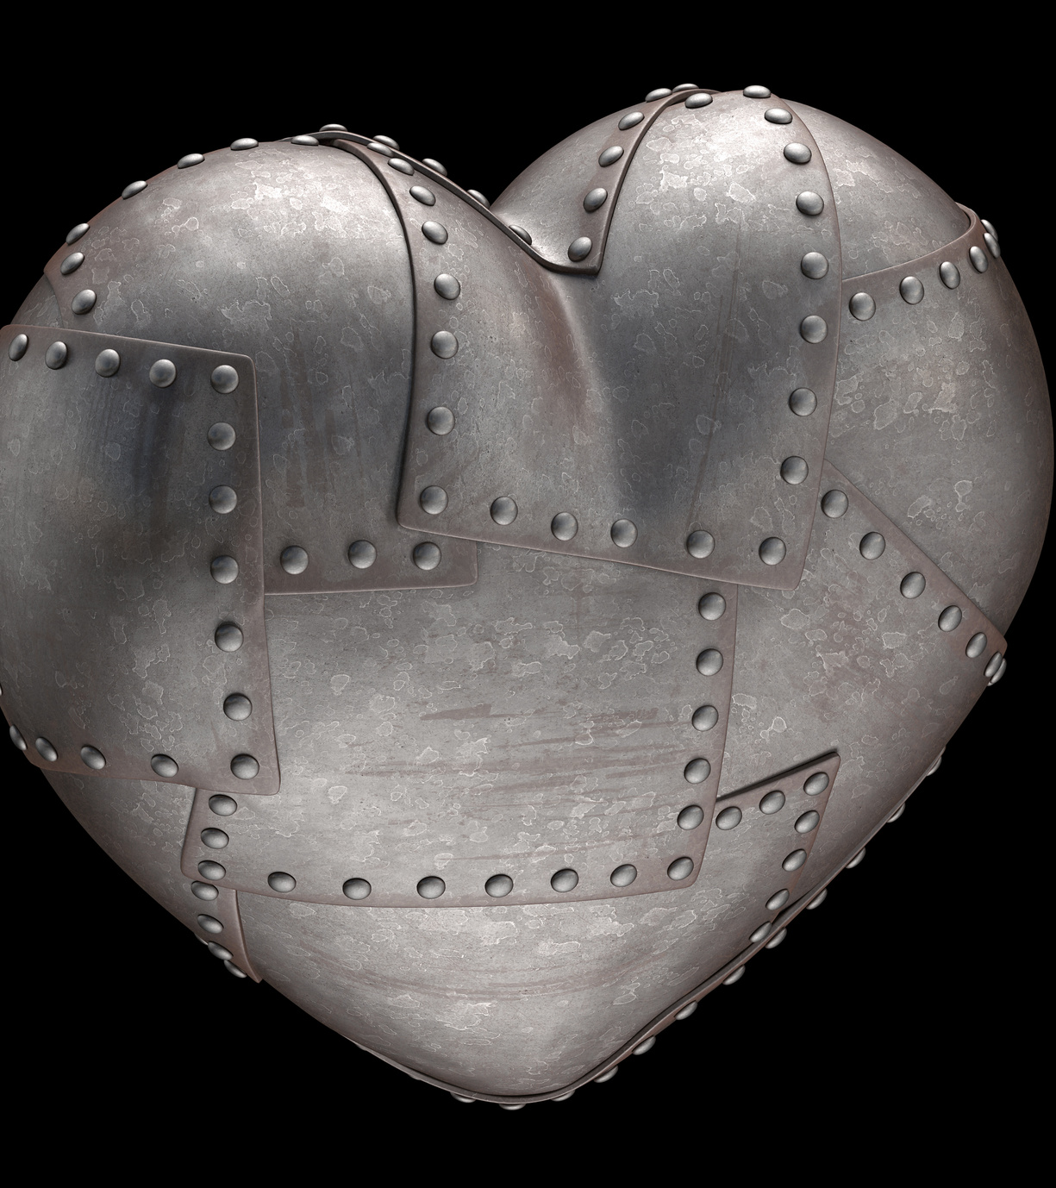
How is it IMPOSSIBLE to Journey Well Before Conversion?
Our spiritual eyes are blind, our ears are deaf, and our hearts are stone—allowing for ZERO spiritual insight
We lived out of the natural inclinations of our sinful hearts, defying God’s rightful authority over our lives:
Eph. 2: 1-3: And you were dead in the trespasses and sins ² in which you once walked, following the course of this world, following the prince of the power of the air, the spirit that is now at work in the sons of disobedience— ³ among whom we all once lived in the passions of our flesh, carrying out the desires of the body and the mind, and were by nature children of wrath, like the rest of mankind
This is the stuff of IDOLATRY: finding life in something other than God
Notes:
Read over entire slide, then: “there’s a theological term describing this…”

Slide 12
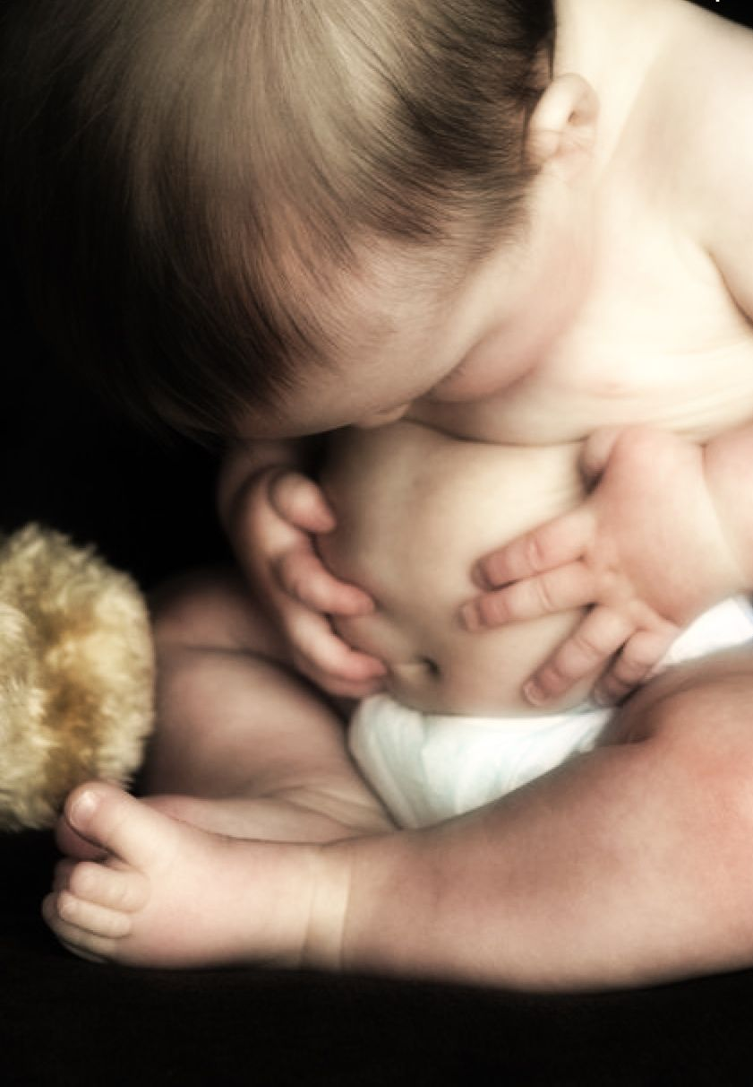
Homo Incurvatus In Se
Sinclair Ferguson:
“When we turn away from [God] in our sin, we fall short of His glory. Something becomes distorted. We focus on ourselves, and everything we do—either obviously or subtly—becomes part of a new liturgy of self-centeredness.
As the English archbishop William Temple said so well, our sin means that we make ourselves, in a thousand different ways, the center of the universe. But then our soul is bent over, turned in on itself. It separates itself from the Source of true life and nourishment, and eventually starves itself of spiritual oxygen, shrivels up, becomes hard, and dies.
Notes:
ALL of our journeys start on this path!
We are born sinful, self-focused, and twisted in soul.
“It’s all about me!” – no, it’s not. This is such an important, basic lesson to learn in life.
“Life is NOT about Me.”
But we all started our journeys ‘incurvatus in se,’ and in this way we can understand each other in our struggle!
I am wanting to rivet this picture in your mind’s eye, because CONTRARY to what you’ll read in self-help books, we DON’T find answers to our struggles by navel-gazing.
Our answers are NOT inside us, requiring more and more scrutinizing of our selves.
In fact, a better picture of this concept…

Slide 13
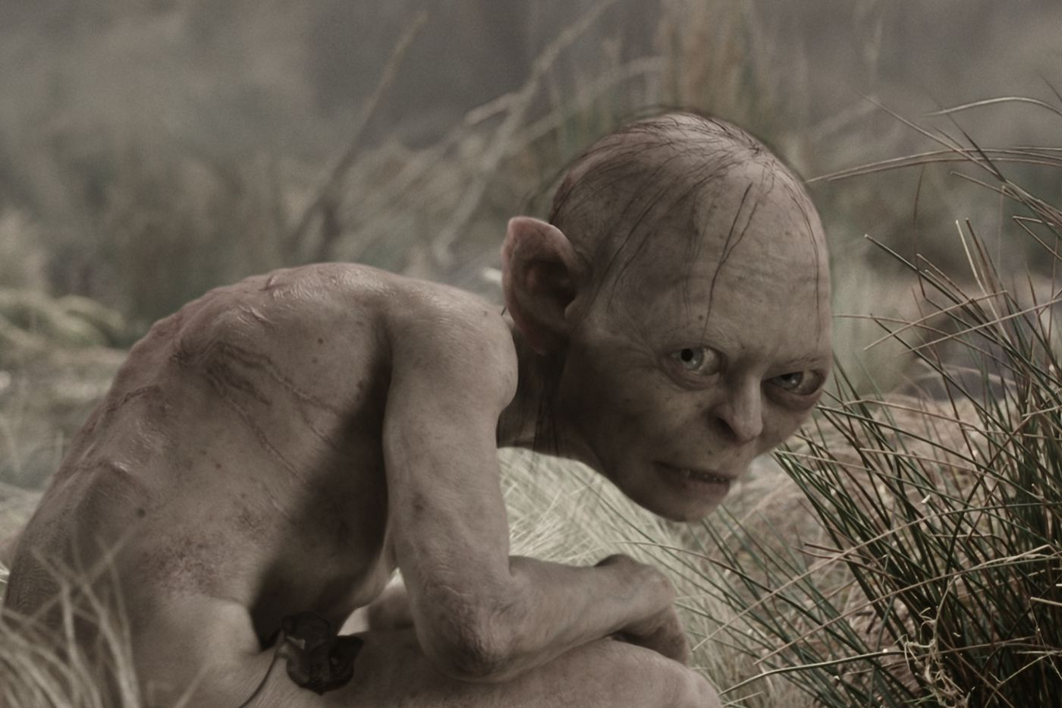
Homo Incurvatus in Se
Notes:
I don’t think any of us much liked the character of Gollum in the Lord of the Rings, but I thought he gave a pretty accurate image of mankind’s dilemma with Homo Incurvatus in se.
Some of you are likely asking, but doctor, why are we talking about sin? We already know all about that!
Because so much of the struggle of living stems from this sinful nature that we were born with!
“The Heart is Deceitful above all things and desperately wicked!”
Our sinful selves want to make life all about ourselves. But we’ve already pointed out that Life is Not About Me.
A second helpful truth that I’ve learned is to “call a spade a spade.”
In other words, by calling an issue what it truly is, we have something we can work with.
Look at Gollum; our human natures are “twisted.” We don’t naturally talk straight.
When we don’t talk straight, we waste a lot of time and energy trying to help people.
As a doctor, I’ve discovered that patients appreciate “straight talk.”
If you’re going to try to help people journey, learn to call a spade just what it is: a spade.
Don’t call someone’s sins “mistakes.” Call it for what it is…SIN.
Why? Because getting stuff out in the open prepares us to deal with it.
So we’ve ALL been here; we all know how sin makes a mess of our lives.

Slide 14
What Happens at Conversion?!
Ezekiel 36:25-27
I will sprinkle clean water on you, and you shall be clean from all your uncleannesses, and from all your idols I will cleanse you. ²⁶ And I will give you a new heart, and a new spirit I will put within you. And I will remove the heart of stone from your flesh and give you a heart of flesh. ²⁷ And I will put my Spirit within you, and cause you to walk in my statutes and be careful to obey my rules
Hearts of Stone become Hearts of Flesh
Blind eyes are given sight
Deaf ears are opened
Notes:
[First] Conversion can be an annoying religious term.
But to those of us who have experienced it, it is very descriptive.
[read slide]
What are our eyes opened to? The gravity of my sin. My humongous need.
What do our ears now hear? They are inclined to the voice of our new Shepherd.
What is so different about hearts of flesh? They truly love God and desire righteousness.
We become truly ALIVE! I’m not a huge fan of zombie movies, but indeed, there is a spiritual concept in them that catches the difference between “the living dead” and being born again to true life!

Slide 15
RC Sproul liked to remind us of what we are saved from when we’re born again: the Wrath of God
Our life journey takes a radical turn when we are born again: ALL THINGS BECOME NEW.
We’re given our new heart in an instant, but the process of thinking God’s way happens little by little. But happen it must.
We cannot take our former way of thinking, believing, and living into a life of surrender to God’s authority.
It simply does not work to continue living out of the old [preconversion] belief system!
Notes:
The wrath of God:
I think of how I shriveled at the wrath of my mother or the wrath of my teacher as a child!
What a blessed reality that I do not have to fear the wrath of God.
I hope you can see where this is heading!
I think a lot of our emotional struggles occur when we fail to realize the actual degree of change that must happen when we are born again.
If we try to continue living out of the same [preconversion] belief system, it simply does not work.

Slide 16
Summarizing
Life is a journey, and we need to practice stepping back and looking at our lives from a bigger perspective than the here and now.
Without spiritual life, our best tools for journeying well are self-discipline, an ethic of working hard, and learning to take responsibility.
But ultimately we cannot journey well because we are Homo Incurvatus in Se – that is, turned inward on ourselves and pre-occupied with everything ME.
Being born again is pivotal in our lives. Truly, all things become new. After having lived incurvatus in se, we lift our heads and turn our gaze AWAY from ourselves and start living with our eyes turned towards God.
Notes:
I often hear myself challenging my friend when we get overwhelmed with the messiness of life:
“Lift up your eyes, Joanne. God’s got this.
He’s big enough to manage this!
There is purpose even in this!”
In other words, “we’ve looked at your belly button long enough; it’s time to exercise our FAITH.”

Slide 17
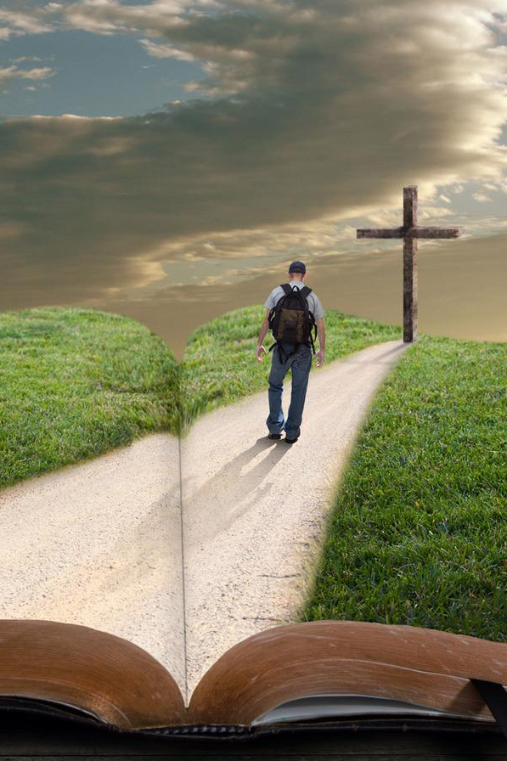
“Bedrock” for Christian Living:
“Bedrock” serves as the foundation
upon which EVERYTHING ELSE rests—
providing stability and support.
Notes:
Moving into the second part of our talk…
[read slide]
…and I chose five concepts which are truly bedrock to journeying well in a spiritual sense.

Slide 18
Bedrock #1: Truth
Sinclair Ferguson again:
“After having started life Incurvatus in se, is there a remedy for this sickness? Is there a Divine pharmaceutical?
There is restoration and healing and transformation for souls curved in on themselves, and it’s available to us in Jesus Christ. His lordship over our lives with our submission to Him as our Savior begins the marvelous reshaping of our souls. That’s why the Son of God came from heaven.
The remedy for the bent soul shape is found in the way the Lord Jesus came into this world that we have distorted, lived a life of perfect soul shape, and then took the judgment of God against all our sinful distortions, and then by His grace gives us not only forgiveness but the beginnings of new life. And as He calls us to trust Him, He gives us the ability to repent, which really means the beginning of the turning back again from the old sinful way, the turning outwards to the Lord, the reshaping of our souls in the likeness of the Lord Jesus.
Notes:
The concepts of repentance and surrender to the Lordship of Christ are not new to any of us here tonight, but I always say that I feel the modern day, 21st century Christian mindset is so watered down!
In the time of the OT prophets, Israel’s culture was so SYNCRETISTIC, which means their religious teachings got all mixed in with other beliefs.
It was no longer pure. But it was very religious, and so they considered themselves high and holy in their sin!!!
You and I have had to grapple with watered-down religion in one way or another.
I am hoping tonight to remind us just how life-changing our decision to follow Jesus actually is! It’s not an ‘oh, by the way’ sort of thing.
Putting this into a counseling context, the contrast between someone bent inwards on themselves and someone who has LIFTED THEIR EYES UPWARD AND OUTWARDS towards God gives a very helpful visual in understanding what brings about true CHANGE in our lives.

Slide 19
Truth
…The whole Christian life is a process of souls that have been sinfully bent out of shape being bent back by grace into shape. That can be a painful process, but it’s gloriously worth it. This is a word for us all, isn’t it, because this soul shape distortion has affected every single one of us. Thank God Jesus can bend us back.”
Truth is foundational to journeying well!
God’s Word is bedrock.
When Scripture makes a statement, it is true—whether I understand it or not.
We must consciously choose to place FULL CONFIDENCE in God’s Word.
Notes:
When I find the impact of Truth on my journey, it in turn is something that will be useful in helping others in their journeys!
What is true for me is true for you!
I’ve already shared TWO truths that were life changing when I learned them:
Life is not about me
Call the spade a space (speaking straight)
Homework for you is to think back over your experience, and write down truths that opened your eyes and gave you firm footing on your journey.
These truths become something you have to offer others in their struggle.
For example:
Modern psychology specifically does the naval gazing thing, looking for who hurt you to explain your struggle today.
Yes, it is helpful to process our life experiences to understand why we do or believe some of the things we do!
BUT TRUTH becomes bedrock as we process what to do with those wounds from others: FORGIVE.
Process your story, but don’t wallow in the sinking sands of naval gazing.

Slide 20
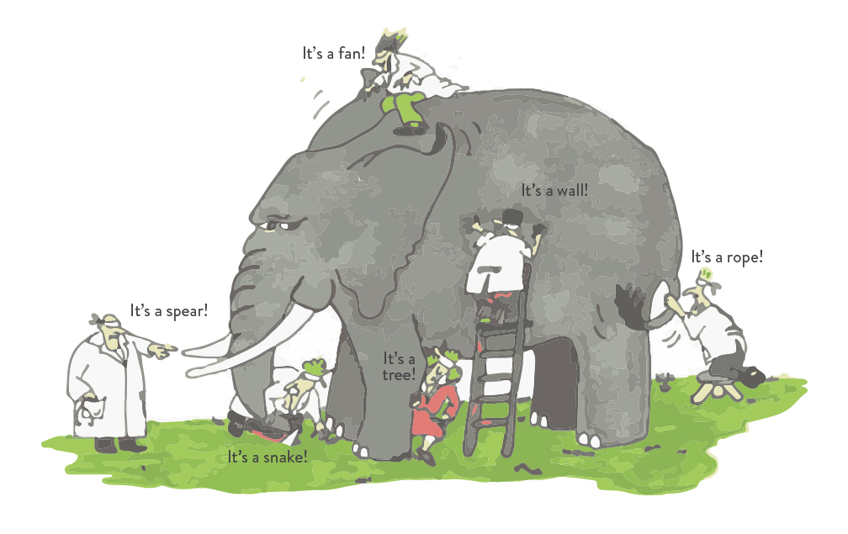
Bedrock #1: God’s Word is Truth. “That’s what is so powerful about God’s Word... What is true for one is true for all! It doesn’t change.”
Notes:
This bedrock of Truth became an incredible anchor to me in the midst of a struggle with a friend.
She ended up deserting the LORD for the pleasures of sin.
I wanted to excuse her…defend her…I didn’t know where to go with her lack of repentance.
I struggled over this for months, and one day Joel made a statement that stopped me in my tracks:
Joel’s comment:….. This was LIFE-CHANGING for me.
I stopped trying to make my friend’s sin excusable, because adultery is always sin—whether it’s my friend or my ungodly neighbor.
It sounds funny, but I found freedom by calling the spade for the sin it was…
AND I found an amazing security realizing how “straightforward” the Scriptures are in matters of Truth.
Truth is not PARTIAL.
What is true for me is true for you.
THIS BECOMES BEDROCK WHEN WORKING WITH HUMAN NATURE
BECAUSE WE NATURALLY EXCUSE OURSELVES
AND WE NATURALLY BLAME OTHERS!

Slide 21
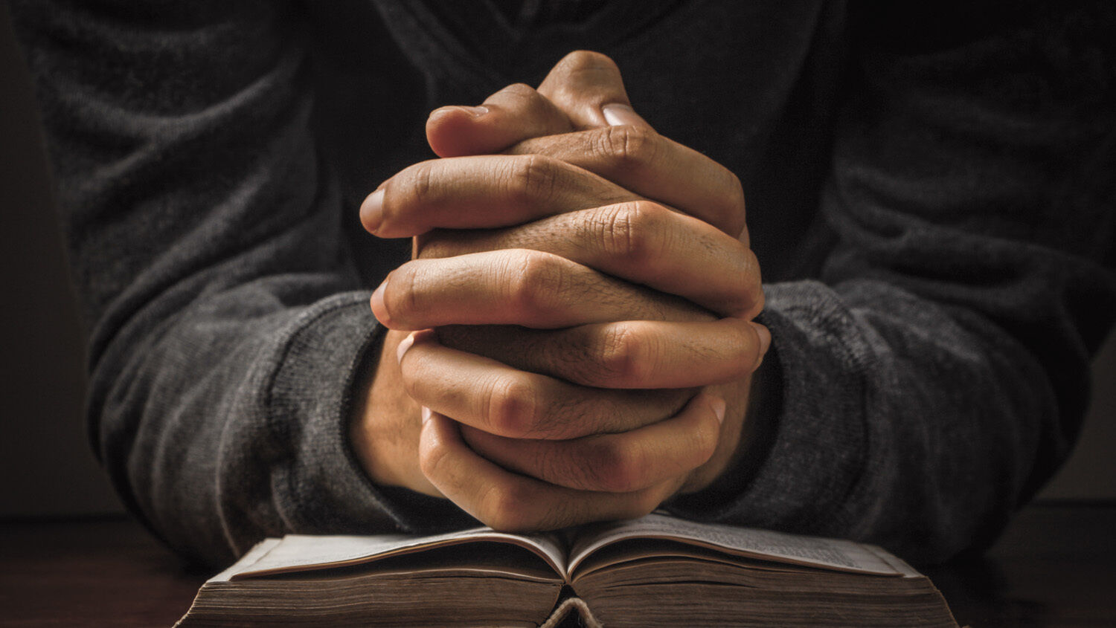
Bedrock #2: Confession
We don’t automatically “get it right” just because we’ve “prayed the prayer.”
We’re not Christians because we figure out how to be GOOD ENOUGH.
On the contrary, we become Christians when our eyes are opened to the depth of our sin and the fact that we’ll NEVER be good enough!
Our entire journey now becomes one of reading God’s Word and aligning our lives to what we read…CONFESSING the sin that it exposes over and over again.
Notes:
Be ye kind…what I did was unkind… Forgive me, Father.
My comment to my patient was so arrogant this morning…Forgive me, Father.
I’m letting my anxiety get the best of me... Forgive me Father…
Of course, our INITIAL confession is summarized in Romans 10:9 – “if you confess with your mouth that Jesus Is LORD and believe in your heart that God raised him from the dead, YOU WILL BE SAVED.”
The Christian journey begins with confession.
But I think it is grossly overlooked at how the journey must continue with DAILY confession.
Why do I say that?

Slide 22
Spirit vs. Flesh
So much of the struggle of life comes back to this ongoing struggle between our flesh and the spirit.
In the same way that we can’t remove the fiber from a stalk of celery, so we cannot remove sin from these bodies of flesh. We fall short of the glory of God. We sin.
“Not being good enough” triggers SHAME. And what does human nature do with shame? We naturally hide.

Slide 23
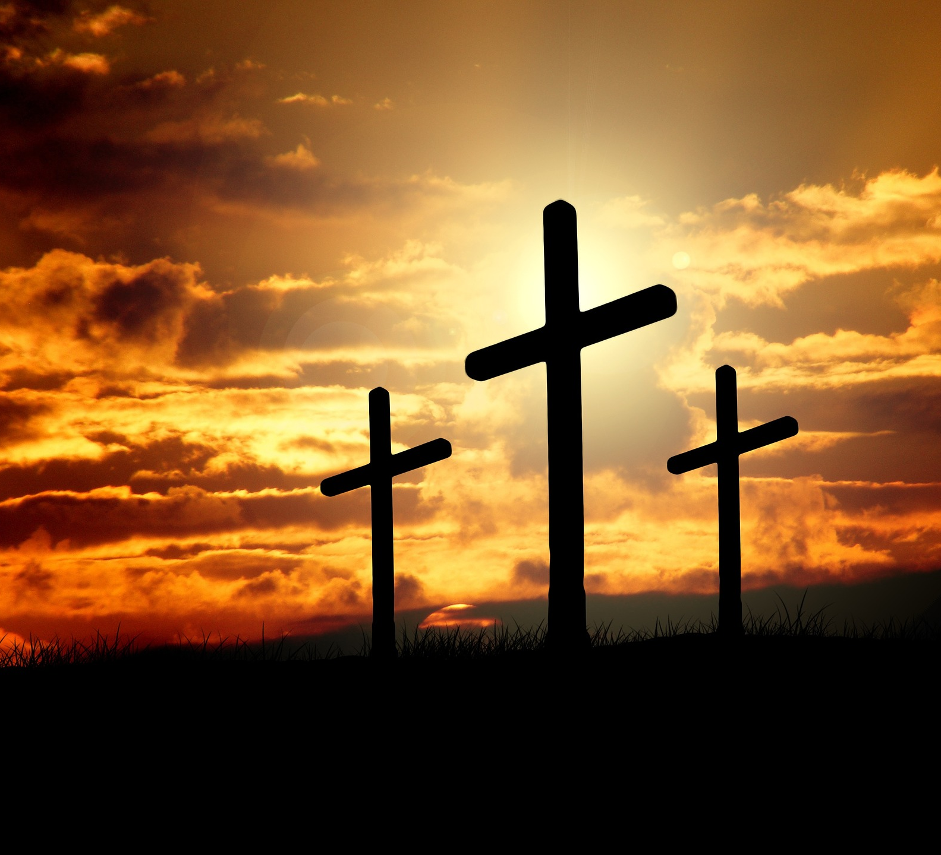
John 3:16-21
¹⁶ “For God so loved the world, that he gave his only Son,
that whoever believes in him should
not perish but have eternal life.
¹⁷ For God did not send his Son into the world
to condemn the world,
but in order that the world might be saved through him…
¹⁹ And this is the judgment:
the light has come into the world,
and people loved the darkness
rather than the light because their works were evil.
²⁰ For everyone who does wicked things
hates the light and does not come to the light,
lest his works should be exposed.
²¹ But whoever does what is true comes to the light,
so that it may be clearly seen
that his works have been carried out in God.”
Notes:
Our natural inclination when we sin (or get it wrong) is to hide.
I picture a bunch of cockroaches scrambling for cover when a big old rock is lifted away from the ground!
Not so as Christians. We ‘come into the light’ with confession.
I remember my moment of personal impact with these verses. In the midst of struggle, I recognized my inclination to hide but I CHOSE to “step out into the light” and let the sin be seen for what it was.
Afterall, why try to pretend that I’m NOT sinful when God sees everything about me anyway!
I’d rather be humbled by my sin today than carry it to Judgement Day!
Friends, tonight, let’s practice this thing called Confession, for it is the certain way to be freed from our sin and our shame.
Find yourself a “traveling companion” who values truth more than the coddling of your feelings!
My friend often says to me, “Tell me the truth, LuAnne. I’d rather hear it straight from you than to live in illusion and carry it with me to judgment.”

Slide 24
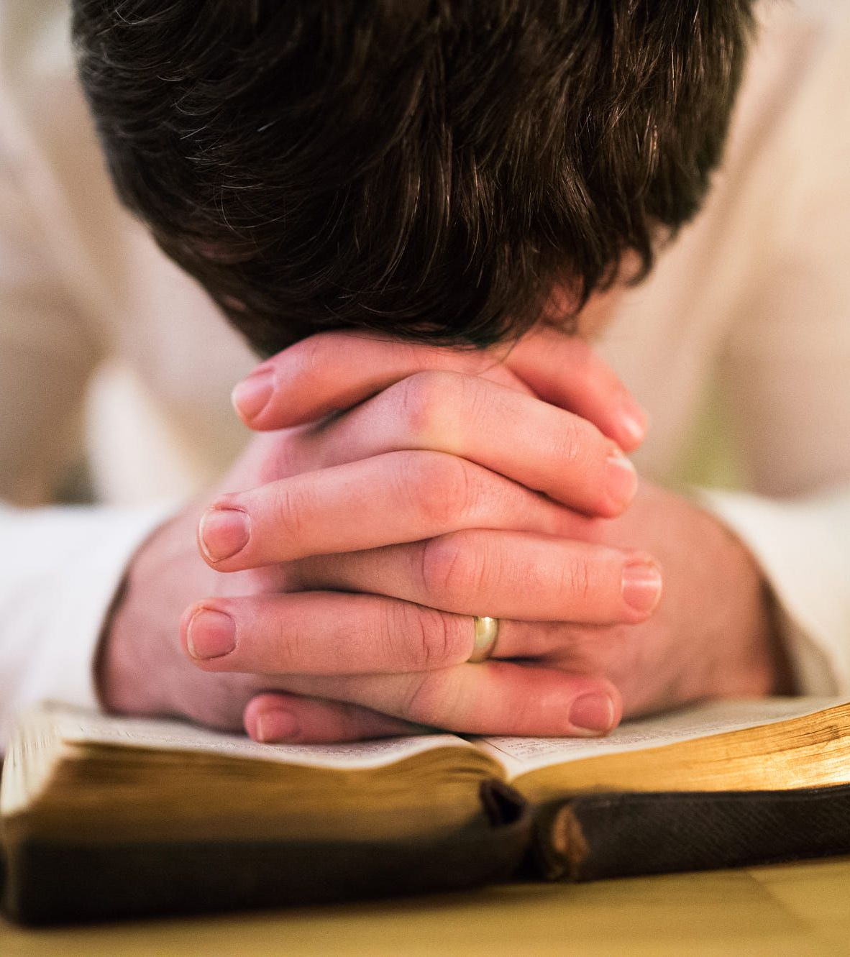
God’s way is CONFESSION.
I Jn. 1:9 “If we confess our sins, He is faithful and just to forgive us our sins and to cleanse us from all unrighteousness.”
We find relief from our shame with the simple act of confessing our sin.
You and I need to practice confession so that we are familiar with what to do with the ugly things that crop up in our own lives. When we are comfortable owning our sin through confession, we know exactly where to lead others when we see them struggling with the shame of sin.
Notes:
[read verse and next sentence]
I read from Romans 10 earlier that “if we confess with our mouths that Jesus is LORD and believe in our hearts that God raised him from the dead, we shall be saved.”
The verses that follow right on the heel of that verse say this:
“For with the heart one believes and is justified,
And with the mouth one confesses and is saved.
For the Scriptures say, “Everyone who believes in Him will NOT BE PUT TO SHAME!”
Finish final point on slide

Slide 25
Bedrock #3: Grace
What does grace look like in everyday living?!
“Unmerited favor” – treated with love or kindness when we obviously do not deserve it
Romans 5:20-21 from The Message:
²⁰⁻²¹ All that passing laws against sin did was produce more lawbreakers.
But sin didn’t, and doesn’t, have a chance in competition with
the aggressive forgiveness we call grace.
When it’s sin versus grace, grace wins hands down…!
The Kingdom of this World is so full of un-grace; we need to show grace!
Notes:
I recently had a patient who was working with OCD, and as our conversation went on, we talked about how her OCD was demanding perfection of not just herself, but also her husband and children. Her OCD was pouring “ungrace” over her entire household, as nobody ever measured up. I challenged her to bring grace into her world—starting with learning to rest in God’s grace to her undeserving heart, and then letting it spill over to her family.
Does GRACE mean something to you?
HOMEWORK: If not, take the next month to look for and identify grace in every-day living:
Yes, there is a ton of “un-grace” out there
But by identifying “un-grace,” you can start to practice pouring grace into those very sorts of interactions!
Remember, it is showing favor to people who don’t deserve it, so it’s often NOT a feel-good experience.
BUT GRACE CHANGES LIVES!
And Grace leads to Grateful Living.

Slide 26
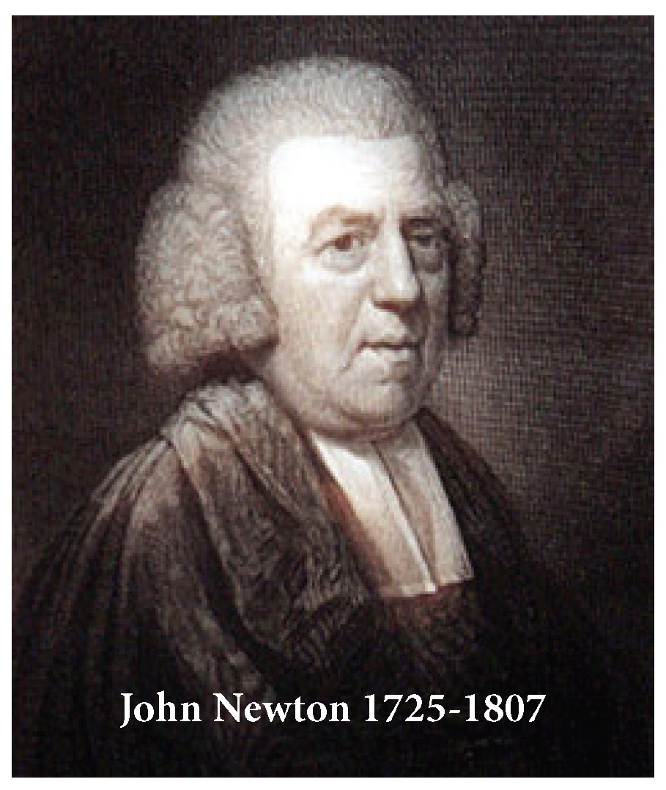
“Hope in this Broken-Down World” by Paul David Tripp
“In its refusal to minimize, diminish, or deny the harsh realities of this broken-down [world], the Bible calls us to face the facts. [call a spade a spade!] However, no child of God can get by recognizing only his or her identity as sinner. The weight of it will defeat you. But you are more than a sinner: you are also a child of grace. These two identities must be held in a healthy tension and balance. Only the person who is deeply aware of his sin gets excited about grace, and only grace can give you the courage to humbly face the enormity of your sin and the brokenness of this world.”
John Newton’s famous quote:
“Although my memory’s fading,
I remember two things very clearly:
I am a great sinner, and Christ is a great Savior!”
One of the most impacting things we have to offer those struggling in our worlds is GRACE.
Notes:
After Newton’s quote: I remember struggling with Jesus’ parable about how those who sin the most are those who love the most.
I actually hated that concept, because I didn’t consider myself a very sinful person.
I wasn’t perfect, but I was pretty good.
Christ’s words exposed my SELF-RIGHTEOUS heart.
We don’t like to talk about our sin, but grace means nothing if we gloss over sin.
(REREAD the BOLD FACE LINE).

Slide 27
Bedrock #4: FAITH
The greatest realities in life are those which are unseen.
2 Cor. 4: 16-18 - ¹⁶ So we do not lose heart. Though our outer self is wasting away, our inner self is being renewed day by day. ¹⁷ For this light momentary affliction is preparing for us an eternal weight of glory beyond all comparison, ¹⁸ as we look not to the things that are seen but to the things that are unseen. For the things that are seen are transient, but the things that are unseen are eternal.
Journeying well demands that we live with an eternal perspective
Notes:
Here’s one of the “bedrock truths” that helps to straighten our lives:
Before conversion, we do not live by faith; this does not come naturally to us:
In my darkest moments when I struggle with faith, I ask myself the question: If I can’t believe when like is dark, do I believe at all?
And my response is always the same: Lord, I believe; help thou my unbelief!
Short bunny trail…”aren’t you going to speak from a medical perspective at all?!”

Slide 28
Diversion Down the Medical Path:
“Science” = any system of knowledge that is concerned with the physical world and its phenomena and that entails unbiased observations and systematic experimentation.”
- Britannica Encyclopedia
Notes:
How does one observe a spiritual realm that is rooted in FAITH?!
Certainly you can appreciate an obvious “problem” with what the medical world has to offer!

Slide 29
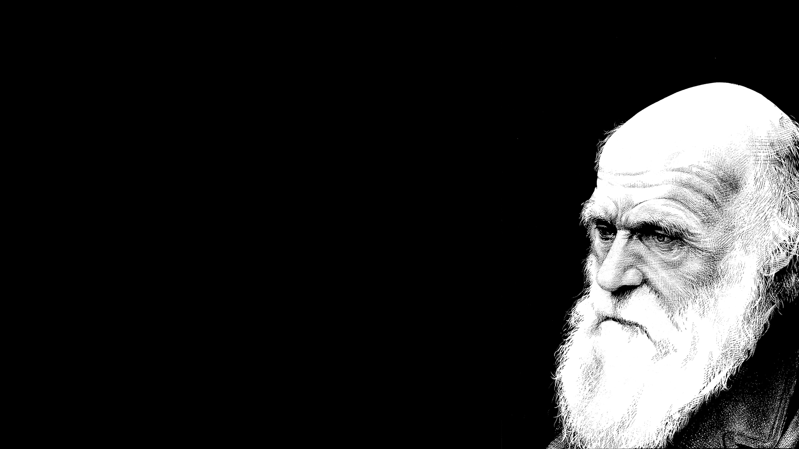
“Unbiased Observations” of the Behavior of Humans Based on Scientific Studies (all the while rejecting God)
Early 1800s: Charles Darwin came up with a theory of existence that did not require a Creator God:
If you remove God from the Origin of the World, then mankind is not accountable to Him!
Initially his theory was met with scorn, but as time moved on, it provided a platform AGAINST religion and eventually promoted a theory to undermine Christianity’s claims
200 years later, here we are, where our entire educational system teaches this as fact!
Is the theory of evolution based on unbiased observations?
Or was it the result of sheer rebellion against the Creator?!
Notes:
[first] I am simply pointing to two famous examples to make my point of why I’m not making this talk more “medical”

Slide 30
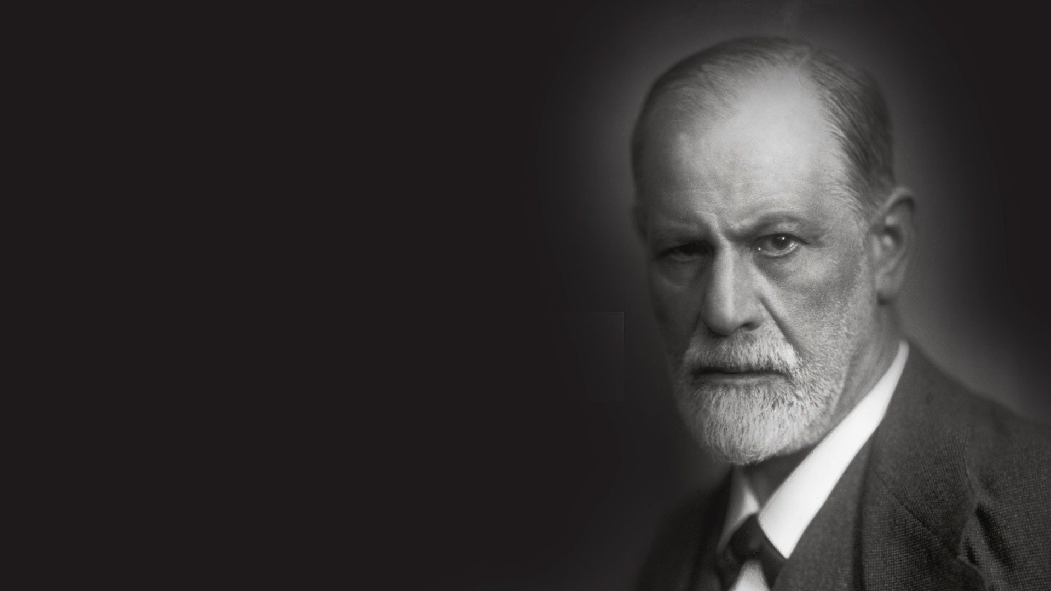
Sigmund Freud
About 100 years later, along came Freud, who is now known as “the Father of Modern Psychology.”
Atheist
He regarded God as an “illusion based on the infantile emotional need for a powerful, supernatural father.”
“Religion, while once necessary to restrain man’s violent nature in the early stages of civilization, can now be set aside in favor of reason and science in modern times.”
Notes:
Our current understanding of psychiatry stands on the shoulders of many scientists such as Charles Darwin and Sigmund Freud—men who determined to create a theory of why we behave the way we do without having God in the picture.

Slide 31
Limitations of the Medical Field—especially in matters of behavior and mental health
Since our spiritual foundation is one of FAITH, “science” has precious little to offer
All of the current mental diagnoses in psychiatry have been defined with the logic of scientific analysis of human nature without accounting for sinfulness!
Using human reasoning to make sense of human behavior is like going on a trip with the wrong map. If you start on the wrong premise, your conclusion is worthless.
Notes:
So Dr. Yeager, you must be saying at this point, “are you anti-science?!”
What kind of doctor are you anyway?!
In the world of medicine, I feel psychology is the specialty that has the greatest limitations in that it studies human behavior without considering God’s diagnosis of the fact that “there is no one righteous—no, not even one.”
So don’t you ever use prescriptions to treat these things?!

Slide 32
Yes, the Diagnostic and Statistical Manual of Mental Disorders (the DSM) is certainly useful in the medical field…
Yes, medication can definitely be useful in calming down extreme symptoms of mental disorders and can help people reach a place where they can be functional again…
Yes, there are different types of therapy which can help people with specific issues (i.e. ‘exposure’ therapy, to mention one)
BUT…always remember that these tools were derived outside of belief in God, devoid of wisdom from the Word of God, or commitment to morality
Hence, while they are helpful at times, they are limited
Notes:
Don’t place your hope in medication!
Use it as you would use a crutch if you broke your ankle
My pathology professor reminded us over and over in his lectures: “Class,” he would say, “there is no such thing as free lunch!”
My point?
While there are benefits to prescription meds, there are down-sides to them as well.
Prescriptions can be helpful to bring stability to unstable situations
I use them, but my preference is to dose as low as possible and for as short as possible
Weigh the risks and benefits: all meds have risks, and many times the benefits outweigh the risks
Kayla’s story (as a GOOD example)
2nd baby – severe anxiety and postpartum depression
Sertraline 100 mg
After 4th baby, hubby says, “Kayla, you don’t engage with me! Even when we’re fighting, you’re so passive”
She very slowly weaned her sertraline, and is currently at 25 mg. I’m pleased with this.
Even if she needs 25 mg for the long haul, that is a heap better than the higher dose.

Slide 33
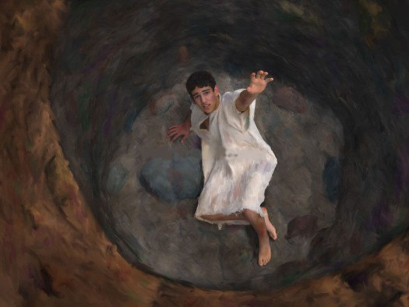
FaiTH
The greatest realities in life are those that are unseen
Hebrews 11:6 - And without faith it is impossible to please him, for whoever would draw near to God must believe that he exists and that he rewards those who seek him
It is BEDROCK to choose to believe in God’s Word even when we don’t fully understand it or feel like it!
Notes:
I put the picture of a pit on this slide, remembering a time when I realized that I was a religious hypocrite!
I knew how to be religious, but I didn’t know God.
The only thing I knew to do is try harder at all the spiritual activities that I had gotten very good at.
I came up with a metaphor of waiting in the bottom of a pit for GOD to come save me:
I refused to let self-help books distract me from waiting for God
If it took the next 50 years of my life, it would be worth waiting for God
Because I WANTED THE REAL THING!
P.S. He didn’t make me wait for 50 years to lead me to Himself. TBTG!

Slide 34
prayer
“The bedrock of the bedrock!”
Bedrock 1 = Truth
Bedrock 2 = Confession
Bedrock 3 = Grace
Bedrock 4 = Faith
Prayer is foundational for true life, for true change, and for true connection as we relate with others.
We need to pray together more!
Notes:
Engaging with TRUTH (Scripture) is communicating with God
Confession is prayer
Grace leads to Gratefulness, which is prayer
And Faith involves prayer!

Slide 35
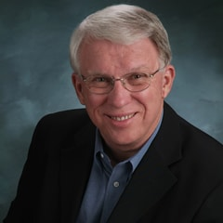
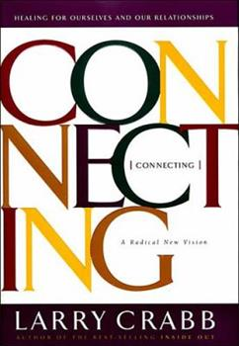
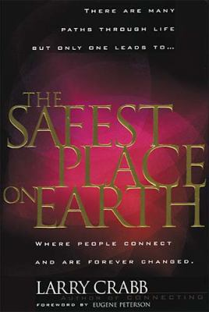
Larry Crabb
Notes:
Larry Crabb left a very insightful perspective to emotional illness for the Christian Church. (He died in 2019.)
He has the highest of credentials, which is a PhD in Clinical Psychology
I haven’t read nearly all his books, but the ones I have read, he said enough for me to get the feel that he is like the Apostle Paul in that he ended up being more impressed with the Truth of God’s Word than he was with all the knowledge gained in his PhD.

Slide 36
Connecting
Dr. Crabb envisions a day when communities of God’s people—ordinary Christians whose lives connect as husband to wife, brother to sister, friend to friend—will accomplish most of the healing that we now depend on mental health professionals to provide.
“We have made a terrible mistake! For most of this century we have wrongly defined soul wounds as psychological disorders and delegated their treatment to trained specialists. Damaged psyches aren’t the problem. The problem is disconnected souls. What we need is connection! What we need is a healing community!” - Crabb
Notes:
Together we can run To the finish line And when you are tired--I'll carry you I can't walk this road without you You cannot go it alone We were never meant to make it on our own When the load becomes heavy And your feet too tired to walk I will carry you and we'll be carried on

Slide 37
Safest Place on Earth:
Dr. Crabb addresses this universal failure of the church head-on and leads us toward a profound new vision of what the church can be—indeed, was meant to be. Rather than a place for people to display their goodness and hide their failures in fear of censure, the church should be open, supportive, and compassionate in dealing with our weaknesses. It should be “the safest place on earth,” a place of true spiritual community where people…
Understand that brokenness is the pathway to a deeper relationship with God and others
Connect in ways that create a passion for God deeper than all other passions
Believe in the power of spiritual friendships as the best care for hurting souls
Reach that sacred place of vulnerability where lives are forever changed
At such a place, there s no expectation that people have arrived at some level of perfection; it’s a place where people journey toward God.
Notes:
At the end of the day, Crabb wanted to empower the church to turn to each other to process this journey of life rather than immediately jumping to the secular world and its humanistic guidance.
If your heart is stirred and you want to process this lecture in greater depth, I would recommend Crabb’s books!
In this book, Crabb gives a mental image which I think is so helpful when trying to figure out where to go with myself or the person sitting across from me…

Slide 38
Crabb’s “Lower & Upper Room”
LOWER ROOM = living from the flesh
C.S. Lewis calls it “the cesspool”
Wretchedness—our own wretchedness—must be recognized before true greatness can be properly defined and passionately desired.”
“I must give up whatever idols I am depending on to give me life… These idols are not doing the job…but I must be persuaded of that before I will give them up. And the only way to persuade me is to convince me that they are not giving me what I most deeply want. Now the hard truth is that I will not be convinced apart from suffering… therefore, I must suffer. When I suffer, I focus better.” p.82
Contrast Crabb vs. Freud
Notes:
A lot of emotional struggle occurs at this point of crisis
HOMEWORK: Can you identify those moments in your own life story?
Moments of severe struggle which ended in a life-changing surrender
Where you abandoned an old idol for God?
We must recognize this struggle in our own stories so we can recognize those moments in our friends’ sufferings
The goal is not to get over the struggle as much as to sort through what there is to learn in the midst of it.
Freud took human wretchedness out of the picture and gave “the flesh” a different title: id. He said if the id is left unchecked, it leads us into psychological difficulty rather than spiritual problems.

Slide 39
Crabb’s “Upper Room”
Whether we eventually experience joy or misery depends on how we view our soul and whether we feed it Christ or something else [i.e. idolatry]. That’s true for every person… The Christian’s soul is regenerated, made alive with the actual life passed back and forth among the members of the Trinity. It is that good life, which I call the Upper Room. (p. 96)
Members of a spiritual community look at each other with the conviction that God has placed something terrific in every member. It may be well hidden, but spiritual energy can see it, call it forth, and enjoy it.
“The safety necessary to own my badness comes when someone believes that I am in Christ and that He is in me.”
There is an Upper Room, but I’m beginning to think that if we try to experience its passions without first smelling the reek of our Lower Room, we will discover only natural virtue, what is really only socialized sin that still comes from the Lower Room. We will be deceived by the effect of air freshener liberally sprayed over garbage.
Notes:
This is why I keep focusing on the uncomfortable subject of sin:
we need to identify the daily struggle with sin in our own hearts
I am startled at how frequently I am seeing mothers looking for something PHYSICAL to blame their toddler’s bad behavior on!
- foods, allergies, thyroid (of course, these can be true, underlying issues)
- our children were born with a sinful nature
- sin is ugly!
when we learn to deal with the sin in our own hearts, THEN we are more prepared to help others deal with theirs

Slide 40
Crabb’s Two Rooms:
This image helps us understand ourselves and others and gives a mental image of how we can begin to engage with those who come to us for help
Tasks of Spiritual Community:
To provide a safe place where all that is true—both the ugly and the beautiful—can be faced (GRACE)
To envision what the Spirit can do…as we wait for Christ to be formed in each other (GRACE)
To discern Flesh Dynamics so that we can hate and abandon them, and to discern Spirit Dynamics so we can nourish and help release them (GRACE)
To pour what is alive in each of us into the other in order to restore hope that the vision can be realized (GRACE)
Notes:
The big word that wraps up what the church has to offer each other is GRACE.
I can’t stress enough the sacred trust when someone shares “the ugly”. It is sheer BETRAYAL if you break confidence in this situation.
We know how slowly plants grow…you know how slowly YOU’VE grown. Be patient with others in their growth.
This looks like a gentleness to me. My friend reminds me of a comment that I made to her once when I admonished her for how “carnal” her comment was. And she is grateful for that!
This is what we have to offer! To me, this looks like lifting someone’s head, turning their gaze from their belly button to see a much bigger, gracious God!
Larry Crabb’s vision was for the church to wake up to the power of the Gospel in ministering to people in need!

Slide 41
Dealing with Addiction:
Ministering to Addicts by Mike McKinley
Two biblical categories can help us understand what is going on in someone's life when they are in the grip of an addiction:
First, addicts are idolaters. Addiction is fundamentally about worship. The Bible tells us that whatever people flee to for solace, comfort, and hope, that thing is functionally playing the role of God in their lives. An addict is someone who is looking to something destructive, something other than the one, true God to take away the boredom, pain, loneliness, or anxiety of life. The joy of addicts when in the presence of the thing they crave—whether that thing is gambling or alcohol or narcotics or pornography—has all the hallmarks of worship.
Second, addicts are slaves. This is perhaps what we most think of when we think of addiction.
Notes:
[first] And now we’re finally looking specifically at a few common emotional struggles.
I can obviously only skim the surface at this point,
But we laid some groundwork before getting here
We are uniquely equipped as CHRISTIANS to support others in their struggles–
NOT because we’re particularly intelligent
But because of how, in very basic ways, we can identify with their struggle
I’m not an expert in the five areas that I’m commenting on this evening, so I turned to Christians who ARE experts in their fields for words of wisdom….

Slide 42
Addiction
These two categories represent a very different way of understanding addiction from that commonly held in the wider world. In most of the medical and psychiatric communities, it is taken as gospel truth that addicts are suffering from a disease and thus are less than fully responsible for their behaviors. But while there is often a very real physical component to addiction, a Christian understanding of sin requires us to insist that God holds addicts responsible for their behaviors and choices.
This understanding also helps to bridge the gap that we may feel between ourselves and the addicts to whom we minister, because when we look at the Bible, we see that the same things that are true of addicts are true of all sinners. By nature and without Christ, every man, woman, and child is guilty of false worship (Rom. 1:21–23). We all exalt ourselves and look to the creation rather than the Creator for meaning and help; we are all idolaters. In addition, apart from Christ, we are all slaves to sin (John 8:34).
If we look at things in that light, we see that we have a basic commonality with someone who is struggling with an addiction.
Summary thought: iPhones
Notes:
And now you can see the reason we covered everything up to this point!
Most emotional illnesses have a component that you and I can connect with…maybe not in details, but the fundamental stuff of human nature.
You’ve already heard me put a plug in AGAINST our iPhones several times already. I am seeing so many issues in the office that I think are related to cell phone addictions.
Insomnia is one of the huge ones, given the way we have blue light glaring into our eyes
It definitely does not help ADHD, but only seems to magnify it
I was problem-shooting with one of my weight-loss patients yesterday, and it turns out that her lack of discipline with eating correlates with how attached she is to her phone
And obviously I suspect our relationships suffer proportional to the amount of time wasted on our phones.

Slide 43
Dealing with the Pursuit of Happiness
“The Pursuit of Happiness” by Ken Myers clarifies the historical understanding of that phrase as used in our Declaration of Independence compared to what it means to our modern mindset
“Since the time of Aristotle and before, happiness was understood as a condition to which all people properly aspire. But the happiness from days gone by had nothing to do with ‘whatever makes you feel good.’ Not at all. It was couched more in the biblical concept of “blessedness,” referring to “a state of human flourishing that aligned the life of a person with the truest good.”
Happiness was therefore “…an ETHICAL, and not a psychological, project. To pursue happiness was to pursue the whole reason for one’s being, but that meant recognizing that one’s desires and actions were in need of correction. It meant accounting for the fact that human beings did not instinctively pursue the truest good, that some very attractive pleasures were not truly in keeping with the most essential contours of our nature. In Christian terms, the pursuit of happiness meant recognizing that God had created us to flourish in the context of obedience to Him so that our image-bearing nature might display His glory.
Notes:
[First] I am discouraged at the number of young people that I see for depression who seem to live with the very faulty concept that we should be able to be happy all the time!
(after reading)….this is the HISTORICAL understanding of the pursuit of happiness.
He goes on to comment how now, pursuing happiness is more about having fun, and having the freedom to do whatever I want to do.
It looks more like the pursuit of PLEASURE, which is extremely self-focused and shallow.

Slide 44
The Pursuit of Happiness
The recovery of a richer vision for human happiness is a project for which Christians are uniquely situated. We believe, unlike most of our contemporaries, that we are made to delight in the knowledge and love of God, to find our fulfillment as creatures only as we walk in His ways. Knowing also that we live in a world disordered by sin, we recognize that true blessedness will often, until Christ returns, involve suffering, persecution, and sacrifice. Our happiness is not a right, but a gift from one who was a man of sorrows, acquainted with grief. To the best of our knowledge, Jesus never asked the disciples: “Are we having fun yet?” But He did teach them that faithful servants would enter into the joy of their master. Happiness is the fruit of aligning our lives with God’s purposes for us…. The pursuit of such single-minded faithfulness, not simple-minded fun, is the true road to human happiness.”
At the end of his life, someone asked A.W. Tozer what he would say to people as a key point to living well: “Tend your Garden.”
“Embrace Blah”
Notes:
Tending our gardens: While fulfilling in the end, garden work tends to be monotonous, and it takes a lot of discipline!
2. Embrace Blah
not every day can be a feel-good day, and that’s OK
For today I choose to “embrace blah” and let the day be what it is

Slide 45
Dealing with the Inevitability of Struggle (Suffering)
Given the dilemma of living with a lower room and an upper room, it should make sense in our minds that the Christian life is a struggle.
I encourage patients to remember that struggle is important. Don’t try to avoid it.
“Coaching and the Suffering Christian” by Joe Holland:
I have spent my life being coached or coaching. I've played most of the major sports and some of the more unusual ones as well. I've learned that coaches face one major perennial challenge. It is the difficulty of motivating your athletes when pain and fatigue are urging them to quit. I’ve found that there are three basic coaching styles that seek to answer this challenge.
The first coaching style asserts that true athletes don't feel pain. It simply doesn't exist; it is a figment of the imagination. This is the mind-over-matter rationale. Pain isn't a challenge; or, it isn't even to be considered. To feel pain is to be weak, these athletes are told.
Nonsense. Everyone feels pain.
Notes:
[first] This next one is not in the DSM, but it’s one of those “spades” that needs to be named.
Too many young folks have an unrealistic expectation that if they can figure out how to do it right, they shouldn’t have to struggle.

Slide 46
Suffering / Struggle
The second coaching style asserts that true athletes love pain. They eat pain for breakfast. They seek pain out. They smile when their fast-twitch muscle fibers are on fire. They love to receive and deliver concussive hits, they are taught.
Nonsense. No one loves pain.
The third coaching style asserts that true athletes, successful athletes, find pain to be a necessary experience in the sport they love. Pain is the friction of growth toward accomplished goals and skill development. These athletes are taught to expect pain, respect pain, and listen to pain as a sign they are progressing. Coaches who adopt this coaching style toward pain tend to produce the healthiest athletes.
Christianity has a point of contact with these coaching styles and the presence of pain and suffering in the life of every Christian. Despite the vain thoughts of the early convert, the life of faith in Christ is not an ascent to heavenly bliss on a pillow of protection and prosperity. The way up is often the way down, a cross before a crown. Whether you are that early convert or a saint seasoned in trials, you will experience pain and suffering in the Christian life with a deep tension—a spiritual, emotional, cognitive, theological, and eschatological tension.
Notes:
1. It would be helpful to let those closest to us see us in our struggles:
Whether you’re a parent or friend, you can model trust and faith by sharing the struggle
struggle becomes a practical opportunity for teaching the value of prayer
my patient wrote a book about their son’s life and death; I was impressed with how quickly the family prayed together
Mothers, don’t be so quick to “save your children” out of moments of struggle!
Use them as opportunities to build character.

Slide 47
Dealing with Anxiety
The most common emotional struggle that I see in the office.
Anxiety is so frustrating because we can’t control it. It’s like a flame that fuels itself, and when we can’t get control over it, it rages into episodes of panic attacks.
When you look at it that way, doesn’t anxiety end up being a control issue?!...as long as we feel like we have our ducks all swimming in the same pond, we don’t tend to struggle with anxiety.
I understand when someone comes into the office with full blown panic attacks, they are at a place in their journey where having a medication which douses the flame helps to move them through this frustrating struggle.
Notes:
Once things have settled, however, it is important to process this struggle with control

Slide 48
Anxiety
Control = an illusion at best?
No given moment any day of our lives that we can guarantee safety from calamity
We have no promise for another “tomorrow”
Can we learn to TRUST GOD with these things we can’t control?
Psalm 139: ¹⁵ My frame was not hidden from you, when I was being made in secret, intricately woven in the depths of the earth. ¹⁶ Your eyes saw my unformed substance; in your book were written, every one of them, the days that were formed for me, when as yet there was none of them.
Notes:
We’ve all been here!
Obviously our greatest anxiety is our own mortality.
This was what landed me in the ER when I was in my early 20s.
I was newly-wed and excited about spending a whole life with the man I loved,
And then it hit me that I could die, and miss out on it all!
Concept: God is the Author of My Story
My story line if I were writing…!
God chose to write the story line of infertility into my life. Can I be okay with this?!!
Every one of us will have a difficult story line somewhere…which becomes our personal training field for practicing the profession of our faith!
Trust is a choice.
I have made the conscious choice to surrender to God’s story line in my life. Have you done the same?
CAN YOU do the same?!

Slide 49
Anxiety
Learning to live despite the presence of anxiety is one of those areas where we should be consciously training our children:
My friend looked for opportunities to train her children to do things that were stretching to them
For those of you whose parents struggled with anxiety, you obviously didn’t have training like this
Don’t play the “blame game.” (That gets you nowhere fast!)
Don’t blame it on the genes. (That is a God-devoid explanation from “science.”)
Start with baby steps and do things despite feelings of anxiety.
Find someone safe to process issues “face-on”
God truly is faithful!
In moments when we feel out of control, SURRENDER is a big hurdle.
Notes:
[my friend…]
Ask the nice lady at Good’s Store where to find buttons
Handing money to the cashier for the candy bar she wanted
Telling her son to go up to an old man struggling with his cart and offer to return it to the cart rack for him
[God is faithful…]
As I was preparing for this talk…! Ps. 56 David from Sight & Sound:
My God, why have you forsaken me?!
I will trust in you!
Seeing God’s purposes in those moments creates trust for the next occasion!
Faith is not always believing everything will turn out the way I want it; but it is learning to trust God even if it doesn’t
MERCYME: “Even If…”
We ALL experience anxiety. Let the struggle with anxiety be something that drives us to God.

Slide 50
Dealing with Depression
What words come to mind to describe depression?
Blackness
Trapped
Hopelessness
A lot of people feel depressed when they experience the absence of feeling good. This is a shallow definition that comes from the pursuit of happiness that we discussed
The real thing is horrendous.
Notes:
[first] This is a huge subject, and we’re barely scratching the surface!
When I was 10 years old, I watched my Mom spiral deep into depression.
Out of respect for her, I’m not talking about that, as she hates that 15-year chapter of her life.
I just had a patient in the past few weeks who felt herself spiraling downward. When I last saw her, she just sat in her chair, looking at the floor, telling me that “I have no hope.”
Depression is worst when one feels hopeless.
When depression is severely inhibiting someone’s ability to even function, I very frequently prescribe pills.
But my emphasis tonight is that pills are not life-giving. Don’t put your hope in finding the “right pill.”
When we use pills, NOTHING CHANGES in one’s external life situation, which begs the question, “what happens inside?!”
Remembering Kayla’s story, the best I can conclude is that there is something “numbing” about it.
That’s not a judgmental statement; It’s me as a doctor trying to make sense of what pills actually do
The Pharmaceutical Industry has pamphlets describing the “neurotransmitter hypothesis” of what these pills do…
But it’s just that—a theory.
Please hear me say that I PRESCRIBE THESE PILLS.
But “there’s no free lunch,” and how can you tell what long-term side effects are???
I think it is sensible to use these like we use antibiotics—short term (which varies!)

Slide 51
Depression
The power of BELIEF:
What we choose to believe make all the difference in how we journey!
Recall BEDROCK: truth, confession, grace, faith, PRAYER!
What is TRUE is more important that how we FEEL
Sometimes trusting God looks differently than what we would think.
We tend to think that trusting God should get us out of depression
Maybe trusting God looks more like surrendering to a long season of darkness, accepting that God has a purpose in this part of my journey rather than thinking this is something that has to end
Notes:
[first] When it comes to depression, I think a key issue under the tip of the iceberg is BELIEF.
[end] I recently told a patient that “I’m not trying to fix your depression.
Depression is a journey, and I’m here to support you through it.
So I will tweak her meds until we find the most helpful combination for her.

Slide 52
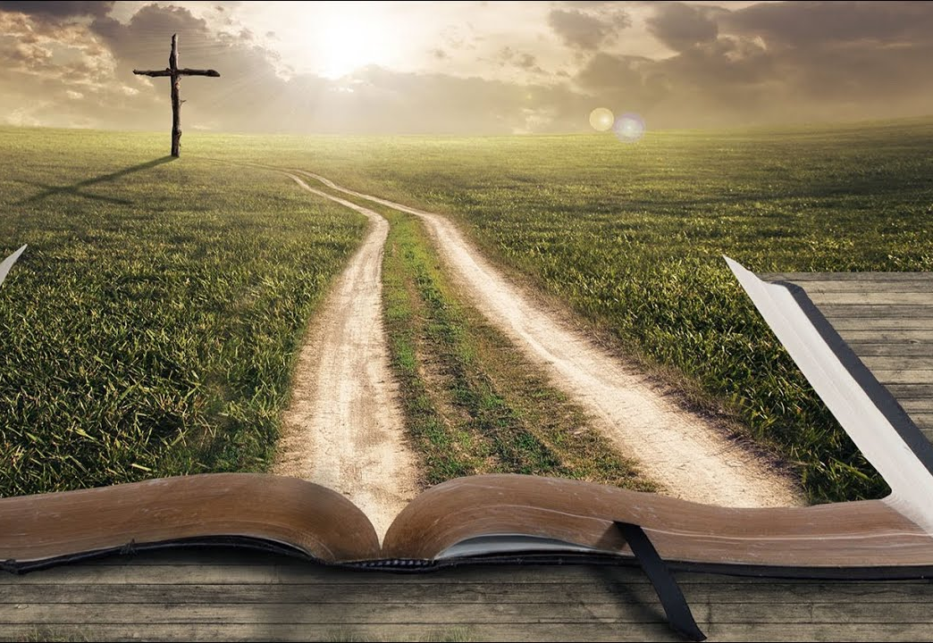
Conclusion
We have this one opportunity to journey well!
It does NOT happen by navel gazing
LIFE is found in God:
look to the things that are unseen
examine YOUR story in the big picture of HIS story
When we honestly do this, we’re bigger sinners than we wish we were!
But then we see just what is so amazing about Grace!
And grace is the tool that God’s people have to offer others that is much more powerful than what modern psychology has to offer
Amazing Grace!
Notes:
I know we’ve covered a ton of ground tonight.
I want to circle back to where we started: relationship!
As Christians, let’s act on the belief that abundant life is found in Christ!
Put your cell phones out of reach
Keep “first things first,” which is time of solitude, with our Bibles and Prayer
And then look for connection on things that matter with a fellow believer
Find a “traveling companion” or two who are as committed to TRUTH as you are, and then walk together.
HOMEWORK: be in touch this week with someone who has been a safe place for you and THANK THEM.
Don’t do this with the entire church; even Larry Crabb says that this circle of vulnerability is small
Be honest about the struggle with sin in your own heart, and remember the power of confession
Remember that the best way to help others is to have the courage to step out into the light ourselves.
Our lives have been changed by the grace of God
And because of that grace, we can become a “safe place” for people to confess their struggles without the fear of being scorned or rejected.

Slide 53
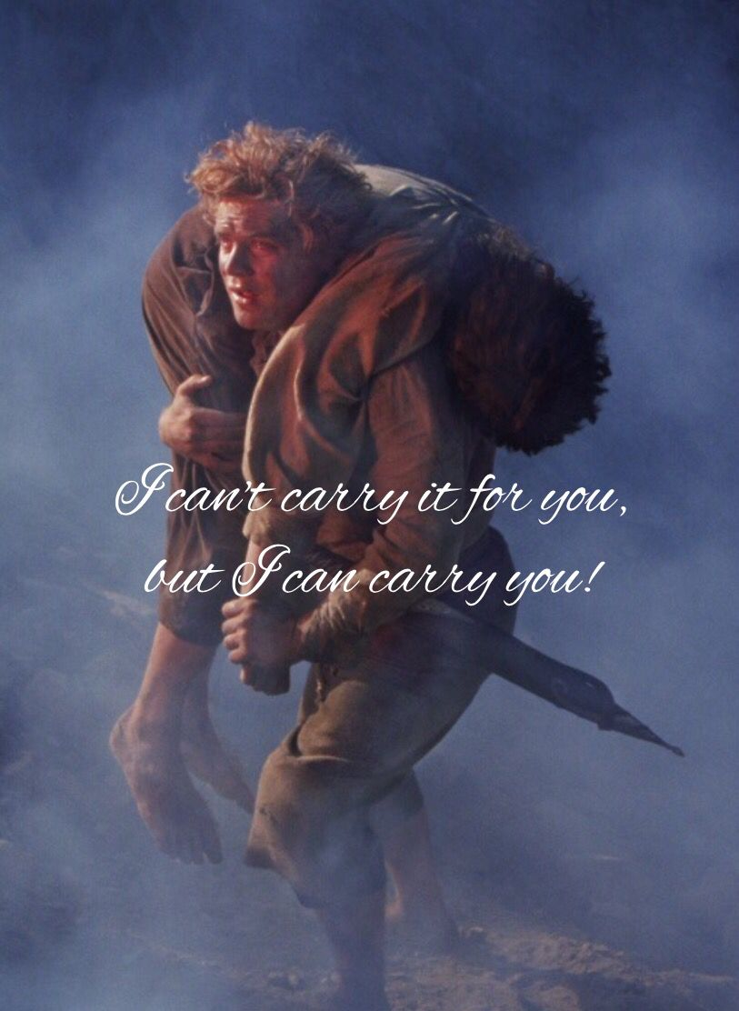
I know that look in your eyes I see the pain behind your smile Please don't hold it all inside Together we can run to the finish line And when you are tired, I'll carry you
Share your burden now; I will listen And when I'm weak Will you hold me to the truth That we can go on, for we are carried Three strands of chord Cannot be easily torn...
I can't walk this road without you You cannot go it alone We were never meant to make it on our own When the load becomes heavy And your feet too tired to walk I will carry you and we'll be carried on
Notes:
And one more time, the song by Rebecca St. James….
Heavenly Father,
Give us courage to walk in the Light of Your Word.
Continue to transform us into Your Likeness.
I pray that You will blossom many relationships in this room tonight
Who commit themselves to engage honestly and openly together as TRAVELING COMPANIONS in their life journeys.
Where we don’t get it right in our relationships (because all of us respond poorly sometime or other!),
may we be quick to forgive and use those failures as stepping stones.
Thank you, Father, that you are a God who is gracious and merciful,
Slow to anger and abounding in steadfast love and faithfulness.
We pray this in Jesus’ name. Amen.

Slide 54
Thank You!
Email:
lyeager@heritagefamilyhealth.org

